Slide 1
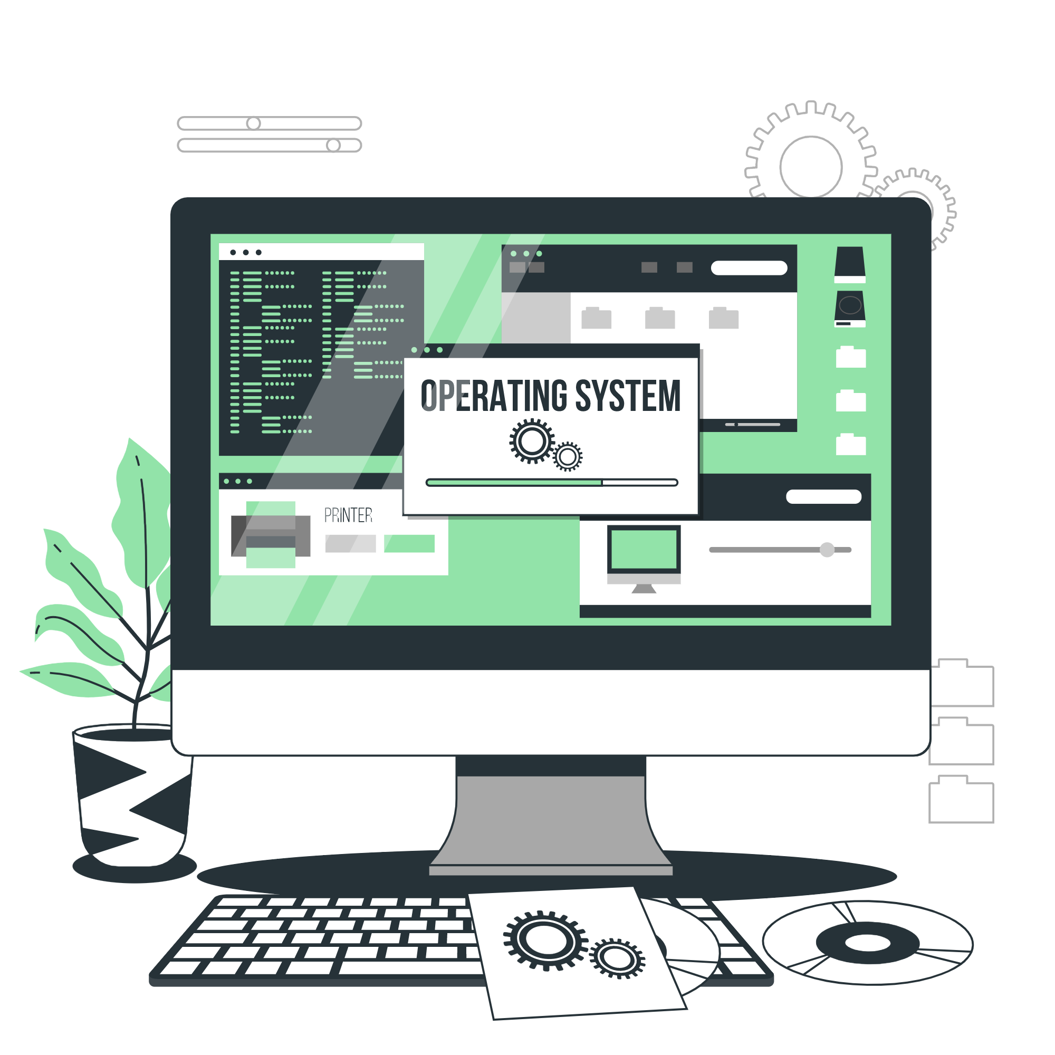
Operating System
Basics

Slide 2

Different Operating Systems and Their Features

Slide 3
What is Operating System(OS)?
Operating system (OS) is a software layer between the computer hardware and application programs.
It manages and controls computer hardware resources like memory, CPU, and input/output devices.
It provides a platform for running application software and acts as an interface between the hardware and user.
It acts as a resource manager and provides basic services like memory management, process management, file system management and security.
It enables users to interact with the computer and perform tasks.

Slide 4

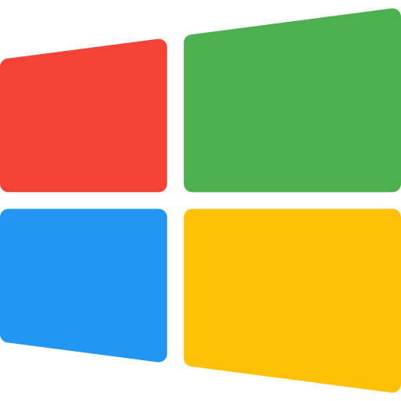

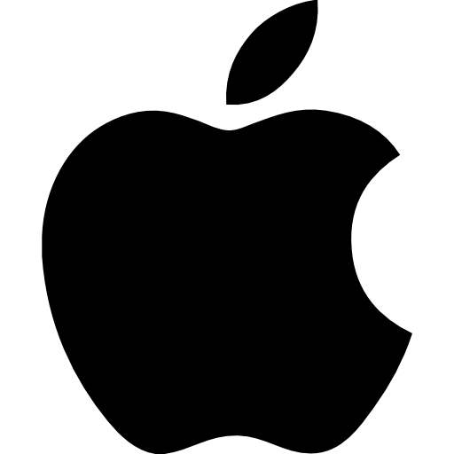


Types of Operating Systems
Windows
Mac OS
Linux OS
Chrome OS
Android OS
iOS

Slide 5
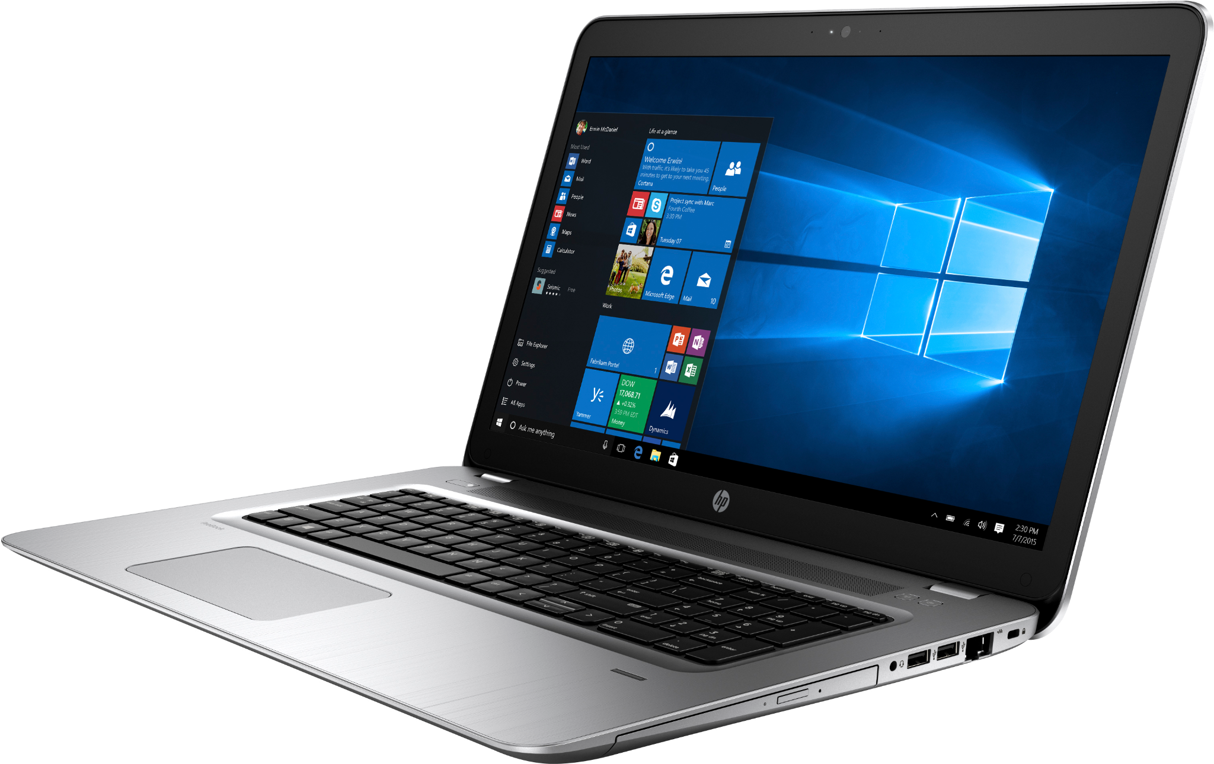

Windows OS
Designed by Microsoft
Developed mostly in C, with some parts in assembly language.

Slide 6
Windows OS (cont.)
Windows OS is developed by Microsoft.
First released in 1985 and has since been updated multiple times with the latest version being Windows 11.
Featuring the first graphical user interface for IBM-compatible PCs, the windows OS soon dominated the PC market
Commonly used on personal computers and laptops.

Slide 7
Advantages of Windows OS
User-friendly interface: Provides a easy to use and navigate user interface.
Compatibility: Windows is compatible with a wide range of hardware and software
Widely used: Windows is the most widely used operating system in the world, making it easy to find support and resources for troubleshooting and problem-solving.
Regular Updates: Microsoft releases regular updates and patches to fix security vulnerabilities and improve performance.

Slide 8
Advantages of Windows OS (cont.)
Integration with Microsoft Products: Windows integrates well with Microsoft Office and other Microsoft products, making it easier for users to work across platforms.
Large App Library: Windows has a large library of apps, including both Microsoft and third-party apps, providing users with a wealth of options for productivity, entertainment, and more.

Slide 9

Disadvantages of Windows OS
High cost of licensed versions.
Vulnerability to viruses and malware.
Resource-intensive nature, may slow down older hardware.
Limited customization options compared to other OS.
Compatibility issues with older software and hardware.
User account control and privacy concerns.
Occasional software and security update issues.

Slide 10
Intended users of Windows OS
Gamers: Windows offers a wider range of games than any other operating system and provides compatibility with many popular gaming platforms.
Home users: Windows is easy to use and offers a wide range of apps and features that cater to everyday computing needs, such as web browsing, email, and multimedia consumption.
Traditional PC users: Windows is the most widely used operating system and offers compatibility with a wide range of hardware and software, making it a good option for users who prefer to stick with what they know.

Slide 11
Intended users of Windows OS
In short, Windows OS is preferred by users who need an easy way to interact with their computer, and intends to do a wide range of tasks like productivity, multimedia tasks, gaming, etc.
These users don’t mind paying more or even sacrificing some hardware performance for that ease and versatility in use.

Slide 12
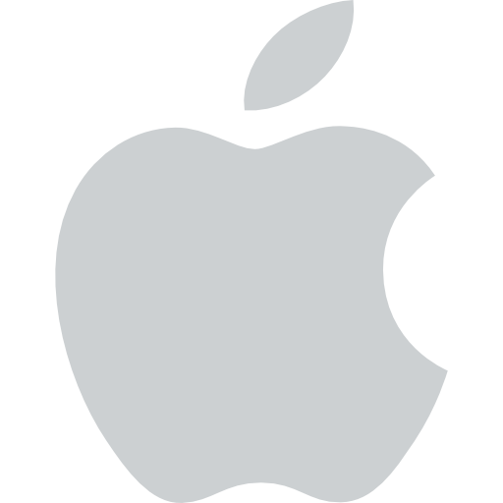
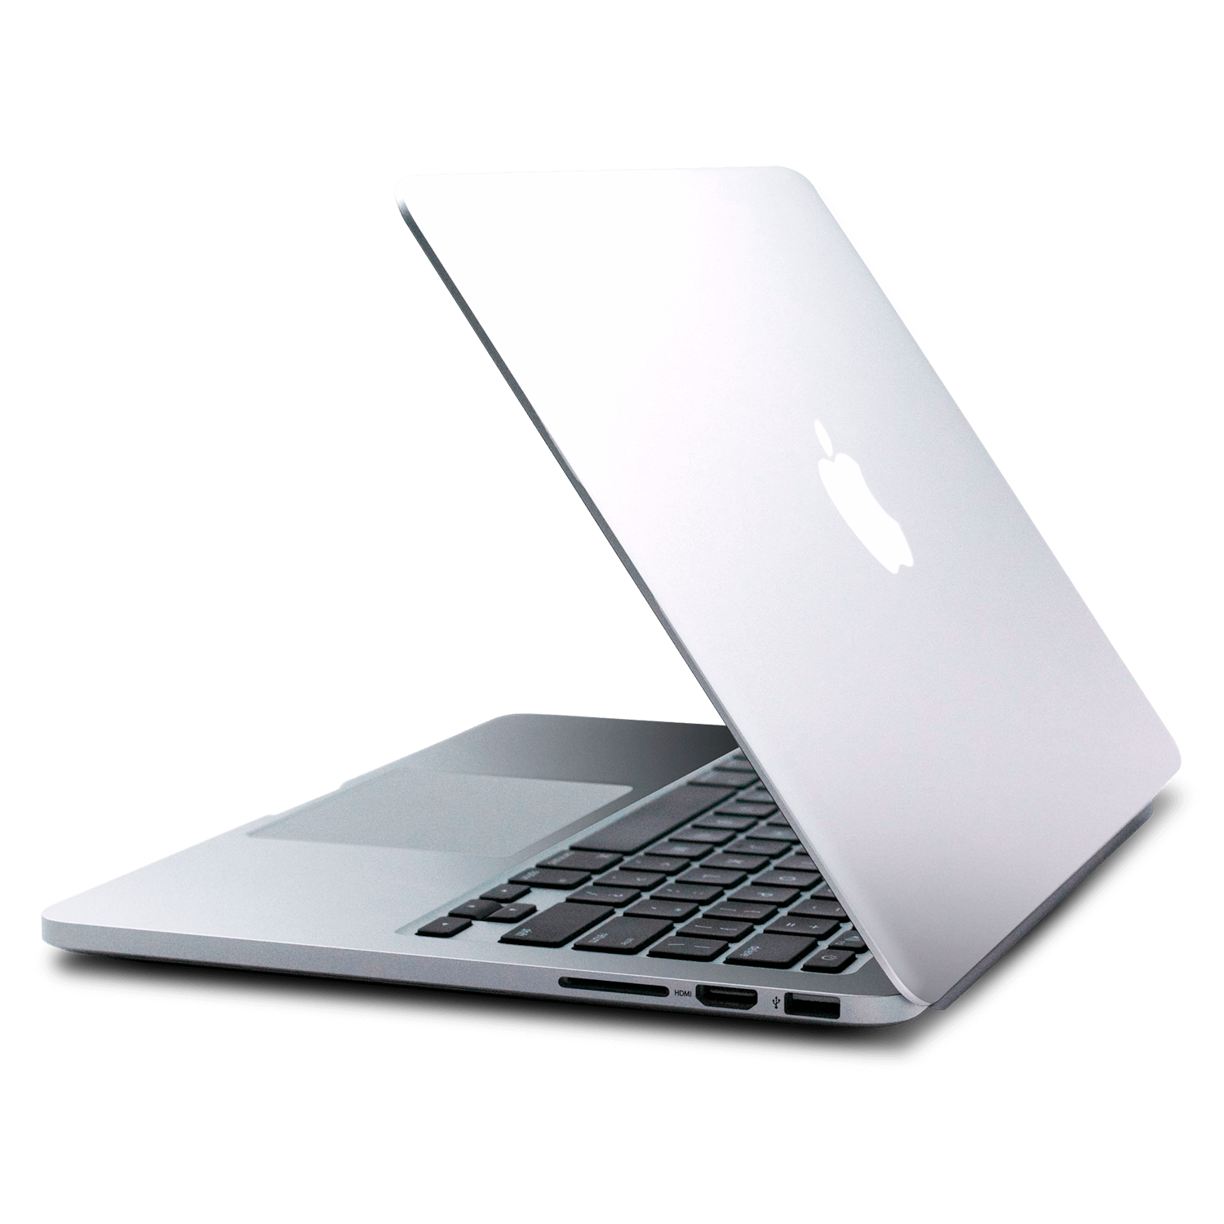
Mac OS
The classic Mac OS was introduced in 1984 with the first Macintosh and was widely used until Mac OS X was introduced in 2001
Developed mostly in C++, Objective C and Swift

Slide 13
Advantages of Mac OS
User-friendly interface: Mac OS has a user-friendly interface that makes it easy to use, even for those who are not tech-savvy.
Integration with Apple hardware: Mac OS is optimized to work seamlessly with Apple hardware, resulting in a smooth and fast user experience.
Robust security features: Mac OS has robust security features, such as Gatekeeper, which helps prevent malware and malicious software from being installed on the system.

Slide 14
Advantages of Mac OS (cont.)
Regular software updates: Mac OS receives regular software updates that add new features and improve security and performance.
High-quality graphics and multimedia capabilities: Mac OS provides high-quality graphics and multimedia capabilities, making it ideal for tasks such as photo and video editing.
Good stability: Mac OS is known for its stability and reliability, which makes it less prone to crashes and other technical issues compared to other operating systems.

Slide 15
Disadvantages of Mac OS
Higher cost for hardware compared to other operating systems.
Limited software compatibility compared to Windows OS.
No official support for playing games.
Limited customization options compared to Windows OS.
Lack of compatible hardware support.
Dependence on Apple's proprietary software and hardware.
Not suitable for intensive multitasking and demanding applications.
Limited support for virtualization compared to Windows OS.

Slide 16
Intended users of Mac OS
Creative professionals: macOS is the preferred operating system for many creative professionals, such as graphic designers, photographers, and video editors, due to its compatibility with creative software, high-quality display, and powerful hardware.
Mac enthusiasts: macOS is favored by users who appreciate the sleek design, seamless integration, and stability of Apple's hardware and software ecosystem.
Education and research: macOS is widely used in education and research due to its stability, security, and compatibility with scientific and academic software.

Slide 17

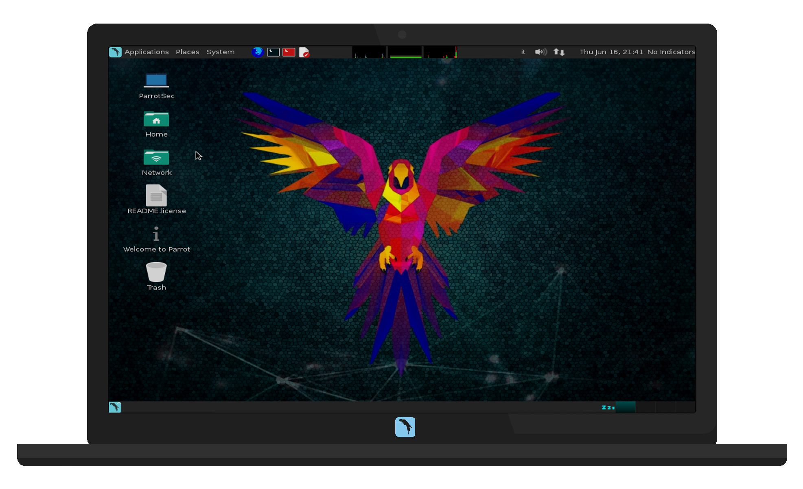
Linux OS
Linux is a free and open-source operating system based on Unix.
It was created in 1991 by Linus Torvalds.

Slide 18
Advantages of Linux OS
Open-source and freely available.
High level of customization and control.
Wide range of software and applications available.
High level of security and stability.
Cost-effective and low maintenance costs.

Slide 19
Advantages of Linux OS (cont.)
Supports a wide range of hardware platforms.
Large community support and active development.
Efficient resource utilization and performance optimization.
Widely used in cloud computing, servers, and embedded systems.
Flexible and modular design, allowing for easy updates and upgrades.

Slide 20
Disadvantages of Linux OS
Steep learning curve for new users.
Limited compatibility with some software and hardware.
Lack of commercial support compared to Windows and Mac.
Fragmentation among different distributions and versions.
Some difficulty in setting up network and hardware configurations.

Slide 21
Intended users of Linux OS
Privacy-conscious users: Linux is known for its strong privacy and security features, making it a good choice for users who are concerned about protecting their personal information.
Servers and enterprise systems: Linux is widely used as a server operating system due to its stability, security, and scalability, making it a good choice for businesses and enterprise-level systems.
Budget-conscious consumers: Linux is free and open-source, making it a cost-effective option for users who want a powerful operating system without paying a premium price.

Slide 22
Intended users of Linux OS
In short, Linux users are generally are expert or advanced users.
With their expertise, they don’t need ornate ways to interact with the machine.
However, they need more control over their machine and may need to extract every bit of performance the hardware offers.

Slide 23
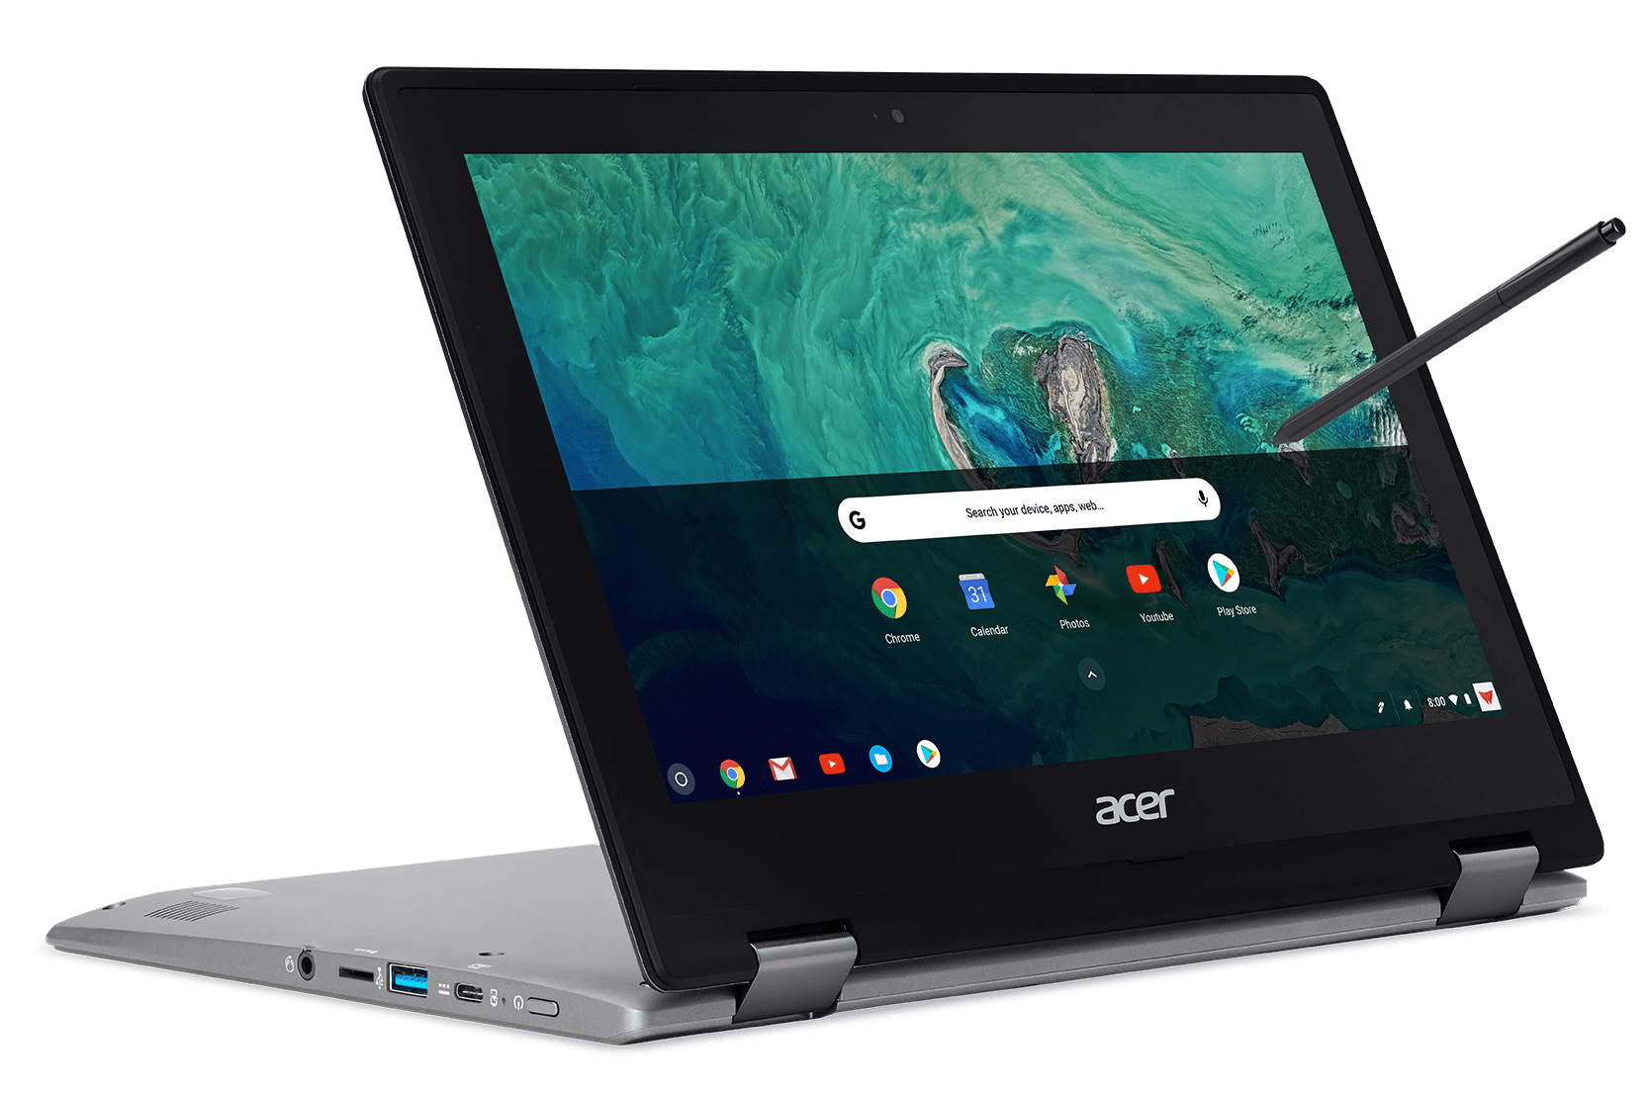

Chrome OS
Designed by Google
A Linux-based operating system
It was first released in 2011 and was initially designed for use on Chromebook laptops

Slide 24
Advantages of Chrome OS
Fast and secure: Chrome OS uses Google’s Chrome browser as its foundation, which is known for its speed and security.
Regular updates: Chrome OS receives regular security and feature updates directly from Google, keeping it up-to-date and secure.
Easy to use: The Chrome OS interface is simple and intuitive, making it easy for users of all ages to use.
Cloud-based: Chrome OS relies heavily on cloud storage and web apps, meaning that most of the user's data is stored in the cloud, not on the device.

Slide 25
Advantages of Chrome OS (conts.)
Long battery life: Chrome OS devices are designed for efficient use of resources, meaning that they have longer battery life than traditional laptops.
Lightweight: Chrome OS is designed to be lightweight and fast, making it ideal for users who need a portable, low-power device.
Integration with Google Services: Chrome OS integrates seamlessly with Google services such as Google Drive, Gmail, and Google Calendar, providing a unified and streamlined experience for users.

Slide 26
Disadvantages of Chrome OS
Limited offline capabilities: Chrome OS is heavily dependent on an internet connection and most of its applications are web-based.
Limited software availability: The number of native apps for Chrome OS is limited compared to other operating systems.
Compatibility issues: Some hardware and software may not be compatible with Chrome OS, making it difficult to use older devices and programs.

Slide 27
Intended users of Chrome OS
Students: Chrome OS is lightweight, easy to use, and offers a range of educational apps and tools, making it a good choice for students.
Businesses with a cloud-based infrastructure: Chrome OS is designed to work seamlessly with Google's suite of productivity and collaboration tools, making it a good choice for businesses that use cloud-based solutions.
Travelers: Chrome OS devices are lightweight and portable, making them a good option for travelers who need a reliable and easy-to-use computing solution while on the go.

Slide 28
Intended users of Chrome OS
In short, Chrome OS is the best choice for light users and to run on lightweight (sometimes inexpensive) machines.

Slide 29
Android OS
Android OS was developed by Android, Inc. in 2003.
The company was later acquired by Google in 2005.
The first commercial version of Android OS was released in 2008
Android OS was initially designed for mobile devices, but it has since expanded to various other devices.

Slide 30
Advantages of Android OS
Open source: Android is open-source, making it easily customizable and adaptable for different hardware devices.
Large app market: The Google Play Store offers a wide variety of apps, including games, productivity tools, and communication apps.
Affordable: Many Android devices are priced lower than iOS and Windows devices, making them more accessible to a wider range of consumers.
Multi-tasking: Android OS allows users to run multiple apps at the same time, which is helpful for multitasking.

Slide 31
Advantages of Android OS (cont.)
Google integration: With Android, users have access to all of Google's services, such as Gmail, Google Maps, and Google Drive.
Versatility: Android is used in a wide range of devices, including smartphones, tablets, and smartwatches, providing users with many options for their technology needs.
Regular updates: Android receives regular updates from Google, providing users with the latest features and security updates.

Slide 32
Disadvantages of Android OS
Fragmentation: Different versions of Android OS run on different devices, leading to compatibility issues.
Security vulnerabilities: Android has faced several security threats and malware attacks, requiring frequent security updates.
Battery drain: Apps and background processes can consume a significant amount of battery life.
Bloatware: Many Android devices come pre-installed with unwanted software, known as bloatware, that can consume system resources.

Slide 33
Intended users of Android OS
Android is the most popular OS for mobile devices.
It is the “swiss army knife” of operating systems, as it can work just fine for cheap and expensive mobile phones and even other smart devices like smart watches, smart TV, etc.
Android OS is the right choice for most users.

Slide 34
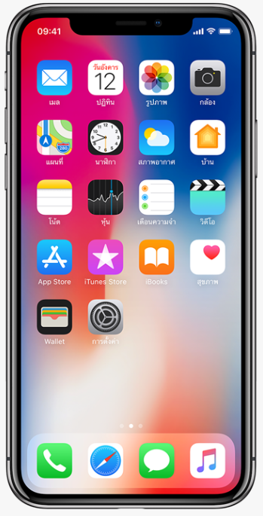
iOS
Developed by Apple Inc. for its line of mobile devices such as the iPhone, iPad and iPod Touch
First released on June 29, 2007, with the launch of the first iPhone.
Initially named "iPhone OS," it was renamed to "iOS" in 2010 with the release of iOS 4

Slide 35
Advantages of iOS
User-friendly interface: iOS has a simple and intuitive interface that is easy to navigate, making it a popular choice for first-time smartphone users.
Security: iOS is known for its strong security features, including secure boot processes and encryption of user data.
Regular software updates: Apple releases regular software updates for iOS, providing users with new features, bug fixes, and security patches.

Slide 36
Advantages of iOS (cont.)
Large app store: The App Store offers a large selection of high-quality, vetted apps for iOS users to download.
Integration with other Apple products: iOS seamlessly integrates with other Apple products, such as Mac computers and Apple Watches, making it a popular choice for those invested in the Apple ecosystem.

Slide 37
Disadvantages of iOS
Higher cost: iPhones and iPads are generally more expensive than comparable devices running other operating systems, such as Android.
Limited customization: iOS is a closed system that limits user customization options, compared to open-source operating systems like Android.
Proprietary software and hardware: iOS is only available on Apple devices, and users are limited to the hardware and software options available from Apple.
Less flexibility: iOS has strict app guidelines and limits the extent to which apps can interact with the system

Slide 38
Indented users of iOS
iOS is usable only on premium Apple smartphones.
It is targeted towards a specific group of consumers only.
For individuals who seek to fully utilize the capabilities of their Apple device family and desire a premium experience with guaranteed security, iOS offers the optimal solution.
These consumers are typically willing to invest a significant amount of additional funds for these premium benefits.

Slide 39
Given a scenario, demonstrate the proper use of User Interfaces (UI)

Slide 40

What is User Interfaces (UI)
A User Interface (UI) is the graphical interface between a user and a computer or other electronic device.
It includes the visual elements, such as buttons, icons, text, and images, as well as the interaction methods, such as touch, mouse, keyboard, and voice commands.
The purpose of a UI is to provide a way for users to interact with a device and control its functionality in a simple and intuitive manner.

Slide 41

Understanding the proper use of UI
A scenario demonstrating the proper use of a User Interface (UI) would be a person using a weather app on their smartphone.
The UI of the weather app is visually appealing and easy to understand, with clear and concise text, bright colors, and intuitive icons.
The person is able to easily navigate to the home screen and select their location using the UI. They are able to quickly find and select their location from a list or by using the device's GPS capabilities.

Slide 42
Understanding the proper use of UI (cont.)
The UI displays the current weather conditions and forecast in an easy-to-read format, including temperature, wind speed, and chance of precipitation.
The person is able to view additional weather details, such as hourly and daily forecasts, by selecting the relevant icons on the UI.
The person is also able to customize their settings, such as units of measurement, using the UI. They are able to access these settings using an intuitive menu and make changes with just a few taps.

Slide 43

Understanding the proper use of UI (cont.)
The person is able to quickly and easily share the weather conditions and forecast with others using the “Share” option.
In this scenario, the proper use of the UI has allowed the person to quickly and easily access the information they need and complete their tasks with minimal effort. The UI is visually appealing and easy to understand, providing an enjoyable and efficient experience for the user.

Slide 44
Advantages of UI
User-Friendliness: A well-designed UI makes it easier for users to interact with a device, reducing the learning curve and increasing efficiency.
Visual Feedback: UI provides visual feedback to the user, making it easier to understand the state of a device and the results of actions taken.
Improved User Experience: A well-designed UI can greatly improve the overall user experience, making it more enjoyable and satisfying to use a device.

Slide 45
Advantages of UI (cont.)
Increased Productivity: A UI that is designed to be efficient and intuitive can increase productivity by reducing the time and effort required to complete tasks.
Accessibility: UI can be designed to be accessible to users with disabilities, making it possible for a wider range of people to use and benefit from a device.

Slide 46
Disadvantages of UI
Complexity: A UI that is overly complex and difficult to use can reduce efficiency and increase frustration for users.
Limitations: UI can be limited by the underlying technology, making it difficult to provide a seamless and consistent experience across different devices and platforms.
Resource Requirements: UI can be resource-intensive, requiring significant processing power and memory to function smoothly and efficiently.

Slide 47
Disadvantages of UI (cont.)
Dependence on Graphics: UI that relies heavily on graphics and visual elements can be difficult to use on devices with limited graphical capabilities.
Cost: Developing and maintaining a high-quality UI can be expensive, requiring specialized skills and resources.

Slide 48

Let’s do some exercises!

Slide 49
Exercises
Create a table comparing the features and specifications of Windows and macOS.
Write the differences between iOS and Android OS
Write a paragraph comparing the user interface and user experience of iOS and Android.
Write a report comparing the App Store and Google Play Store and the types of apps available on both stores
Write a comparison essay on the compatibility and integration of different operating systems with other devices and software, such as smartphones, smartwatches, and cloud services.

Slide 50
Exercises (cont.)
6. Write an essay comparing the ease of use and accessibility features of two operating systems, such as Linux and Chrome OS.
7. A small business owner is looking to upgrade the company's computers. They are considering switching from Windows to mac OS. Create a chart comparing the features of Windows and macOS that would be relevant to the small business owner, such as security, cost, and productivity tools.
8. A college student is deciding between buying a MacBook or a Windows laptop. Write a comparison essay on the features of these two operating systems that would be important to a college student, such as battery life, app availability, and ease of use.

Slide 51
Exercises (cont.)
9. A graphic designer is deciding between using a Windows desktop or a MacBook Pro for their work. Create a visual comparison of the features of these two operating systems that would be important for a graphic designer, such as screen resolution, processing power, and compatibility with design software.
10. An individual is deciding between purchasing an iPhone or an Android smartphone. Write a report comparing the features of these two operating systems that would be important to the individual, such as app availability, camera quality, and security.

Slide 52
Exercises (cont.)
11. A tech-savvy person is considering switching from a Windows desktop to a Chromebook. Write a paragraph comparing the features of Windows and Chrome OS that would be relevant to the tech-savvy person, such as speed, security, and ease of use.
12. A family is considering purchasing a tablet for the children to use for educational purposes. Divide in two groups and discuss the features of iPad OS and Android that would be relevant to the family, such as app availability, parental controls, and durability.
13. An organization is considering switching from Windows servers to Linux servers. Write a paper comparing the features of Windows and Linux servers that would be relevant to the organization, such as security, cost, and scalability.

Slide 53
Exercises (cont.)
14. An individual is deciding between purchasing a Windows laptop or a MacBook for personal use. Conduct a survey in your class and create a bar graph comparing the satisfaction levels of users of these two operating systems.
15. A gamer is deciding between building a Windows gaming PC or a gaming Mac. Write a comparison essay on the features of these two operating systems that would be important to the gamer, such as performance, game compatibility, and cost.

Slide 54
Thanks!

